Slide 1
VIDEO GAME SALES DATASET
- GROUP 16
CB.SC.I5DAS19003
CB.SC.I5DAS19009

Slide 2
OBJECTIVE
HELPS THE DATA ANALYSTS AND STAKEHOLDERS TO HAVE A CLEAR PICTURE OF THEIR SALES AND PROFIT.
HELPS THE PUBLISHERS, DEVELOPER TO KNOW THE INTEREST OF PEOPLE AND ACT ACCORDINGLY.
IT ALSO HELPS IN PREDICTING THE FUTURE OUTCOMES OF THE BUSINESS.

Slide 3
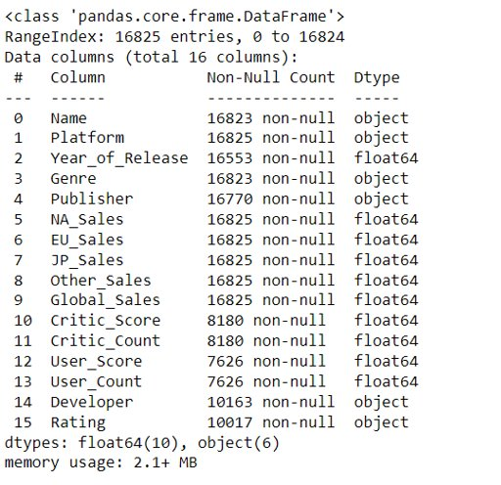
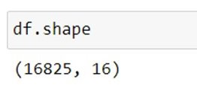
DATASET DESCRIPTION:
THIS DATASET IS ABOUT THE GLOBAL SALES OF VIDEO GAMES WHICH CONTAINS THE SALES OF DIFFERENT COUNTRIES, PUBLISHER,DEVELOPER INFORMATION, ETC..
IT CONTAINS 7 CATEGORICAL VARIABLES AND 9 9 NUMERICAL VARIABLES.

Slide 4
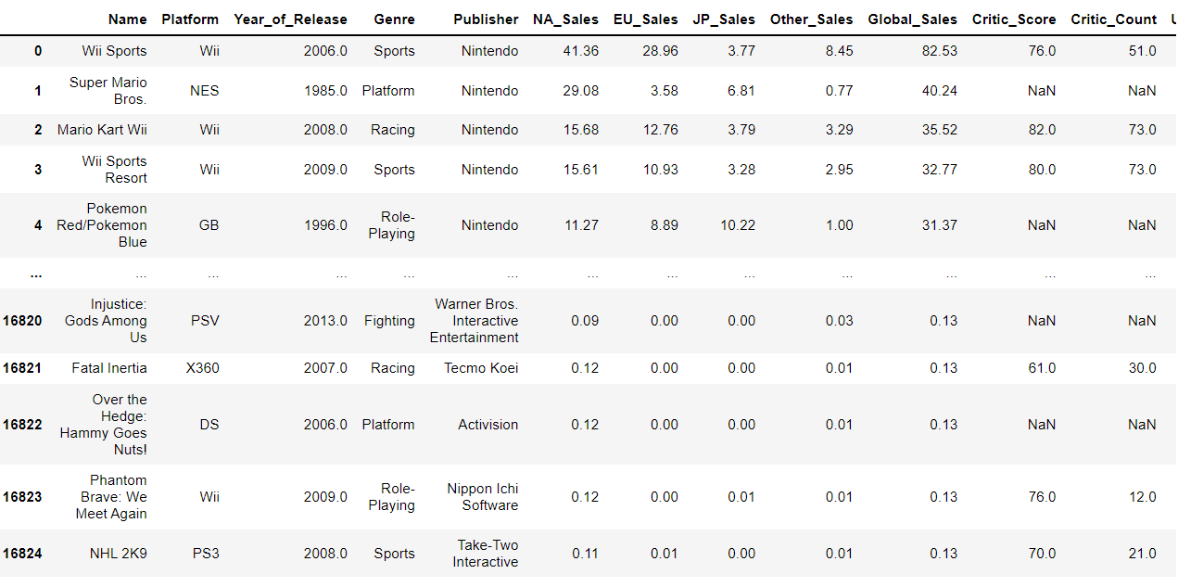
DATAFRAME

Slide 5



DROP DUPLICATES
BE

Slide 6
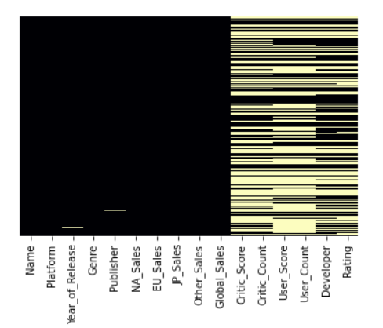
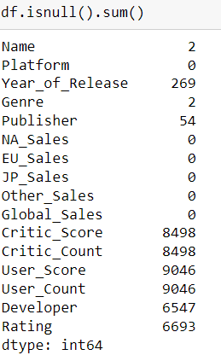
NULL VALUES
DISTRIBUTION OF NULL VALUES CAN BE INTERPRETED FROM THE HEAT MAP

Slide 7
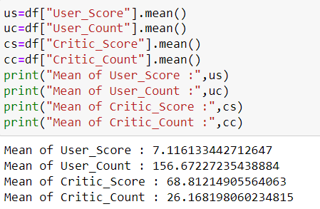
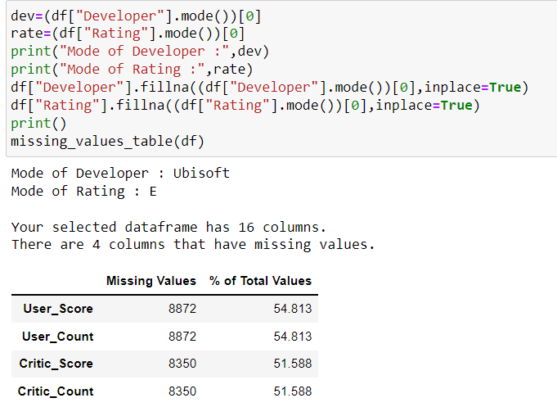
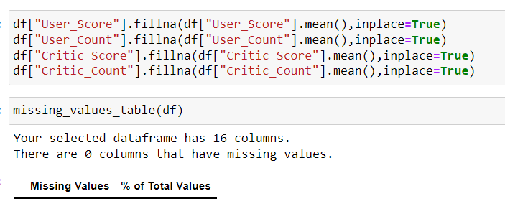
HANDLING NULL VALUES

Slide 8
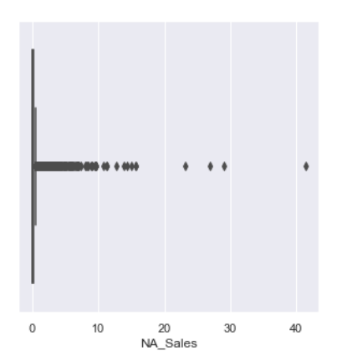
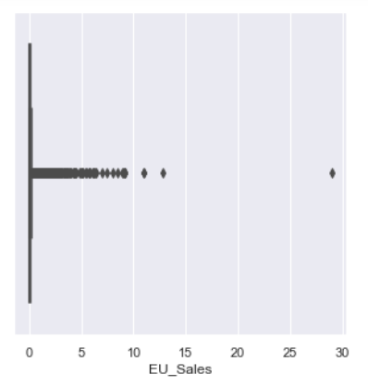
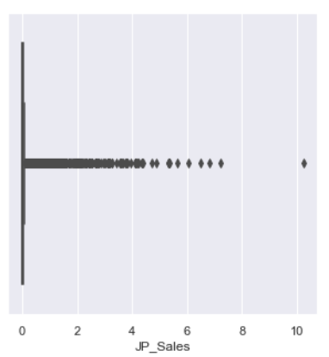



VISUALIZING OUTLIERS

Slide 9
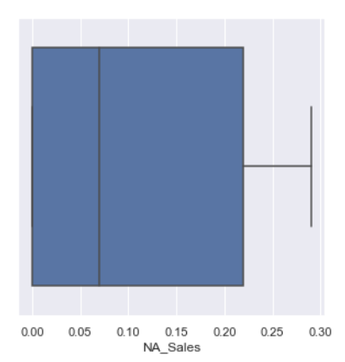
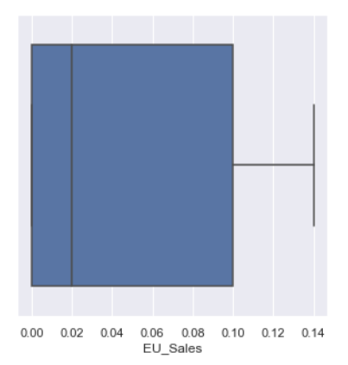
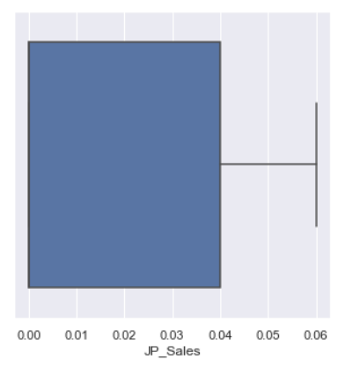
TREATING OUTLIERS

Slide 10
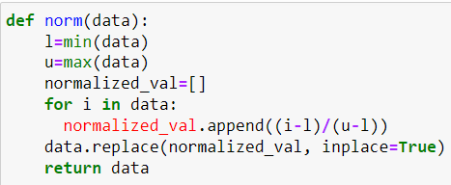
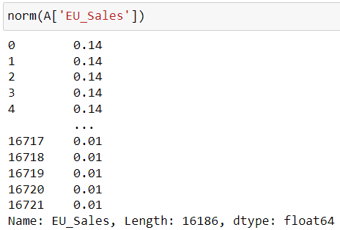
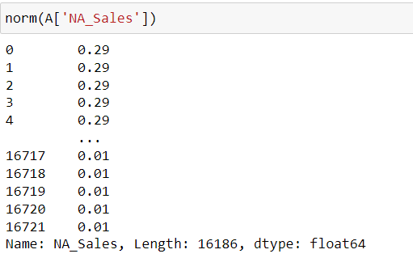
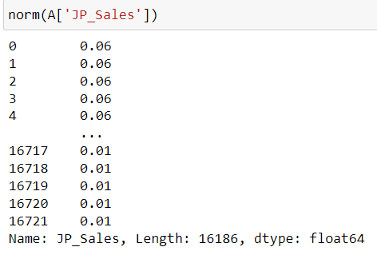
NORMALIZING THE VALUES

Slide 11
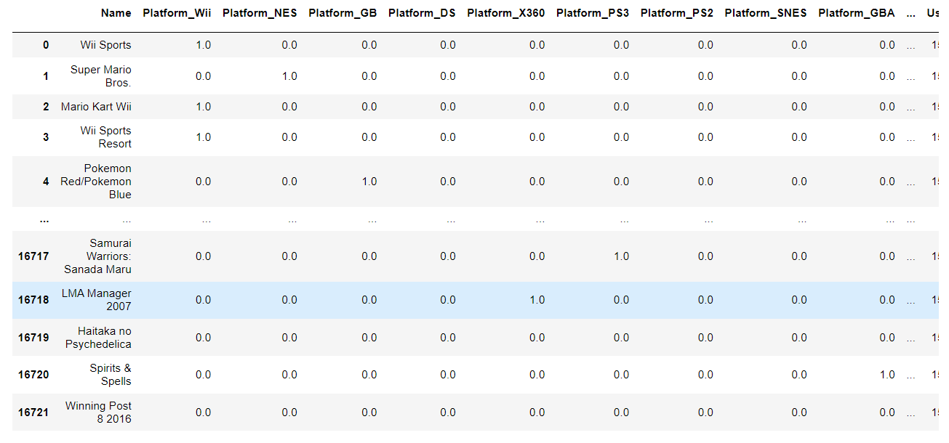
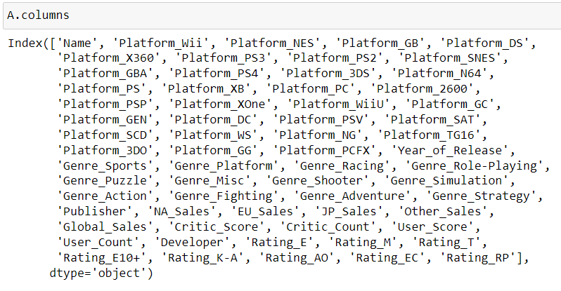
ENCODING OF CATEGORICAL VARIABLES

Slide 12
EXPLORATORY DATA ANALYSIS

Slide 13
UNIVARIATE ANALYSIS

Slide 14
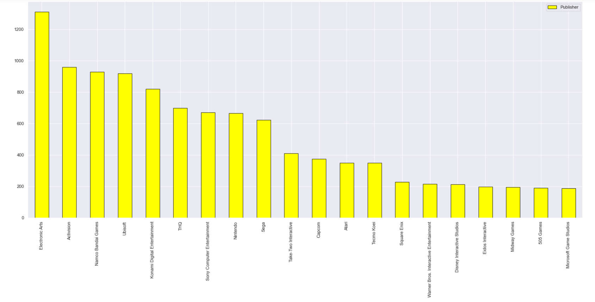
GAME SALES DEPENDING UPON PUBLISHER
THE PUBLISHER ELECTRONIC ARTS HAVE HIGHER SALES OF GAMES COMPARED TO OTHER PUBLISHERS.
THE PUBLISHERS LIKE MIDWAY GAMES, 505 GAMES, MS GAME STUDIO HAVE EQUAL SALES.

Slide 15
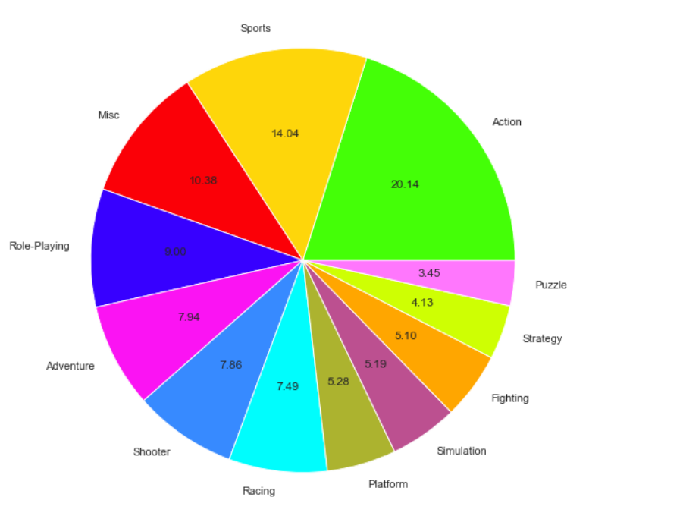
GAME SALES DEPENDING UPON GENRE
DISTRIBUTION OF GENRES WHERE ACTION HAS MOST OF THE GAMES AND PUZZLE HAS LOWER NUMBER OF GAMES.
SPORTS LIKE GENRE, ROLE-PLAYING HAVE INTERMEDIATE SALES.

Slide 16
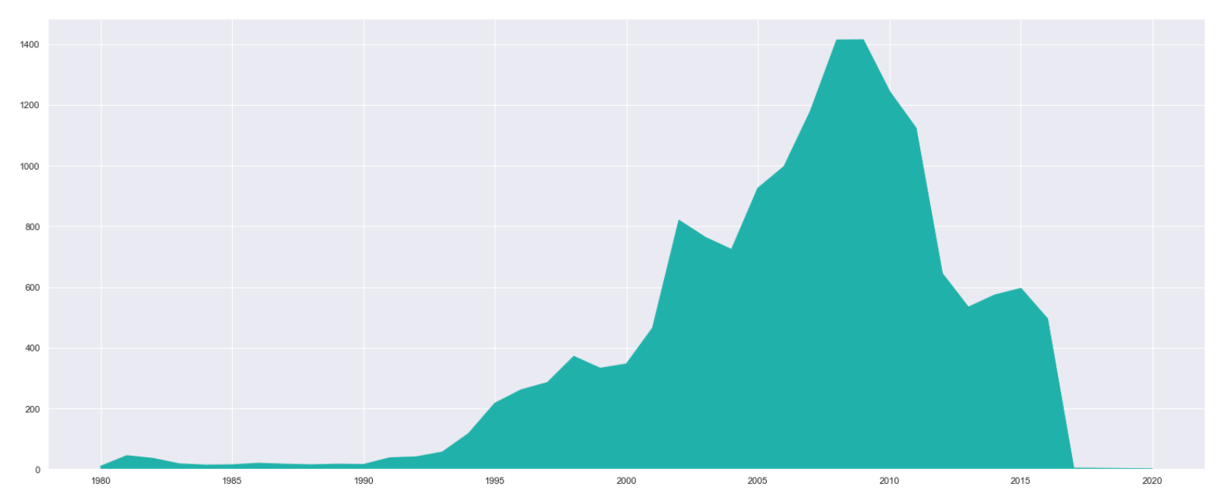
GAME SALES DEPENDING UPON YEAR OF RELEASE
GAME SALES IS HIGHEST IN THE YEAR RANGE OF 2009 - 2010 AND ITS COMPARATIVELY LOWER IN 1980 - 1993​

Slide 17
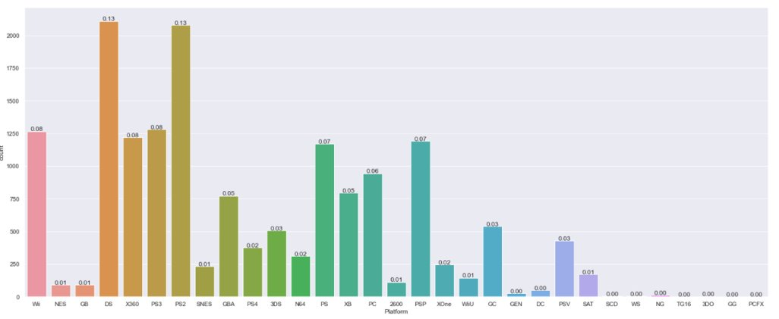
GAME SALES DEPENDING UPON PLATFORM
THE MOST COMMON PLATFORM USED IN THE GAME IS DS AND PS2, WHEREAS THE LEAST COMMON IS NG
PLATFORMS LIKE X360, PS3 HAVE INTERMEDIATE SALES

Slide 18
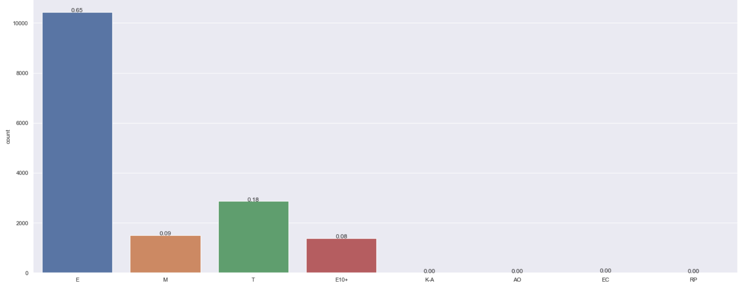
GAME SALES DEPENDING UPON RATING
THERE ARE MORE NUMBER OF GAMES WITH 'E' RATING AND LESSER NUMBER OF GAMES WITH 'E10+' RATING
THERE ARE ALSO SOME GAMES WITH RATING ADULTS ONLY, KIDS ADULTS,ETC.. WHERE THERE IS NO SALES

Slide 19
BIVARIATE ANALYSIS

Slide 20
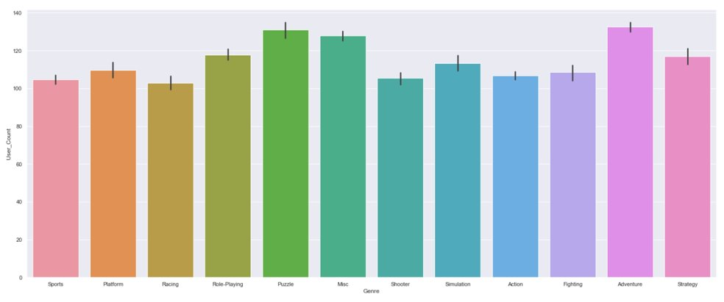
GENRE VS NO OF USERS
THE GAMES WHICH ARE PLAYED IN THE ADVENTURE GENRE WITH REAL CHARACTERS HAVE RECEIVED A GOOD RESPONSE AMONG THE USERS AND MOST PEOPLE OPTED FOR IT.
WHEREAS RACING IS NOT OPTED BY MANY PEOPLE

Slide 21
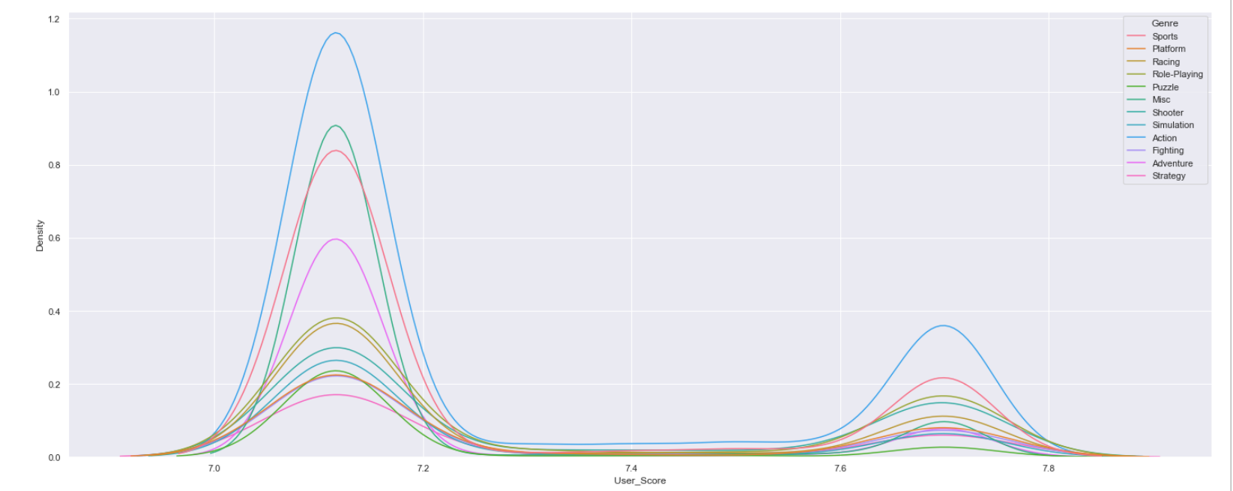
GENRE VS SCORES GIVEN BY USERS
THE SCORES GIVEN BY THE USERS ARE COMPARATIVELY HIGHER FOR ACTION GENRE AND IT IS LOWEST FOR THE PUZZLE GENRE.
GENRES SPORTS AND MISC HAVE MODERATE SCORES.

Slide 22
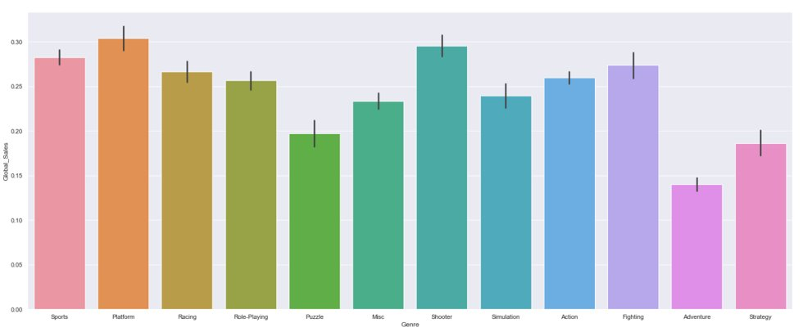
GENRE VS GLOBAL SALES
THE GLOBAL SALES FOR PLATFORM GENRE IS HIGHEST AND ADVENTURE IS LOWEST.

Slide 23
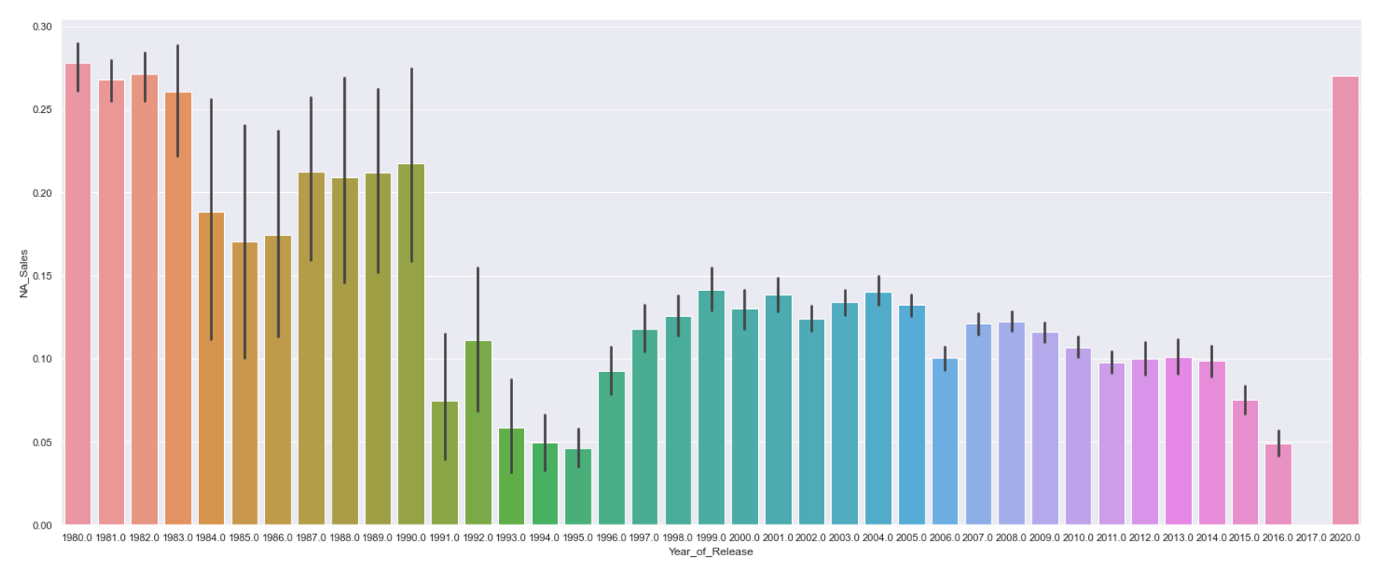
RELEASE YEAR VS NORTH AMERICA SALES
THE SALES OF NORTH AMERICA WAS COMPARATIVELY HIGHER IN THE YEAR OF 1980-1984 AND IT BECAME COMPARATIVELY LOWER AS IT PASSES DOWN.
ALSO, THERE WAS NO SALES IN THE YEAR 2017

Slide 24
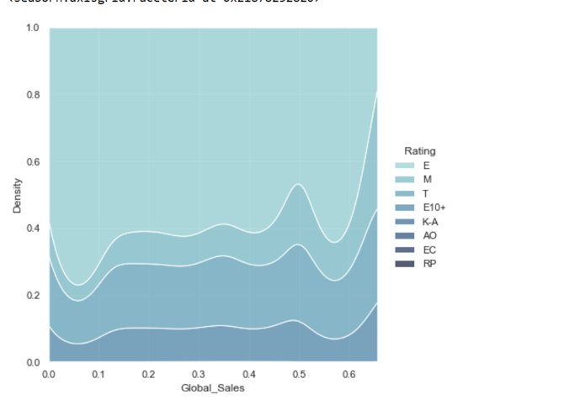
GLOBAL SALES WRT RATING
AREA OF EVERYONE RATING HAVE MORE GLOBAL SCALES AND KIDS&ADULTS RATING HAS THE MINIMUM GLOBAL SALES.
ALSO, THERE ARE SOME GAMES LIKE ADULT ONLY, EARLY CHILDHOOD HAVE NO SALES

Slide 25
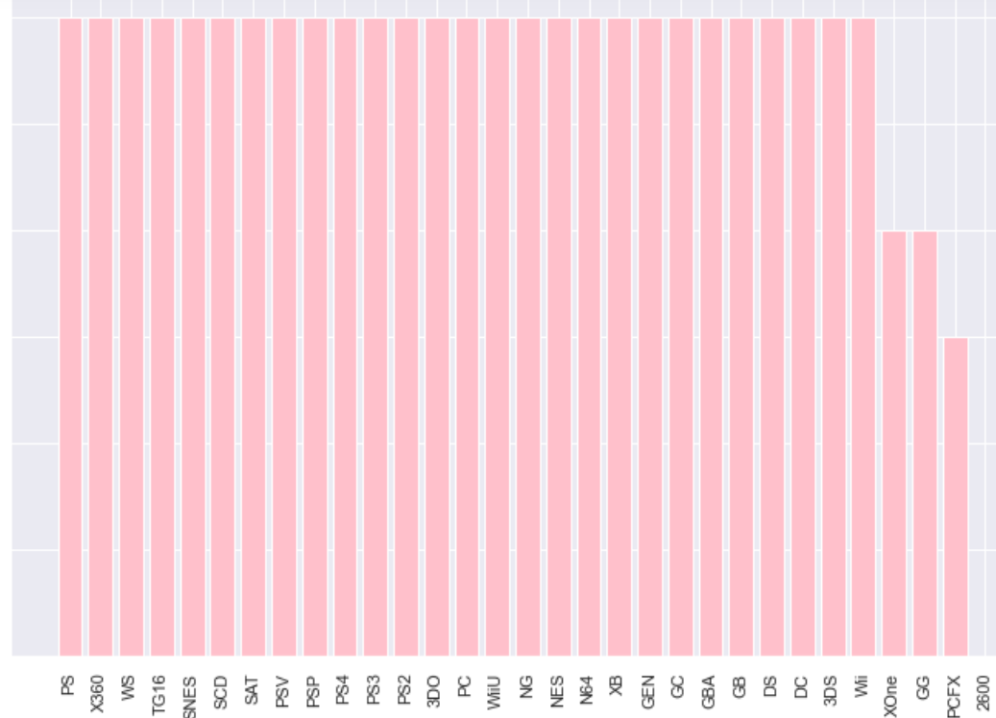
SALES IN JAPAN DEPENDING ON PLATFORM
SALES OF GAMES THAT ARE PLAYED IN PCFX PLATFORM IS LOWER THAN OTHERS.
WHEREAS MOST PLATFORMS HAVE EQUAL SALES IN ALL PLATFORM IN JAPAN

Slide 26
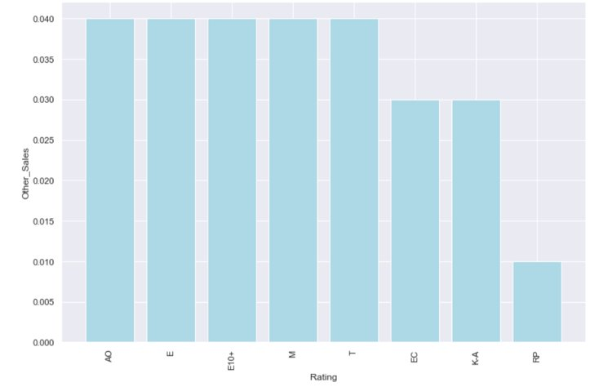
RATING VS OTHER COUNTRY SALES
THE GAMES WITH ADULT ONLY, EVERYONE, EVERYONE ABOVE 10,MATURE,TEEN HAVE EQUAL SALES IN OTHER COUNTRIES
WHEREAS THE GAMES WITH PENDING RATING HAS LOWER SALES.

Slide 27
MULTIVARIATE ANALYSIS

Slide 28
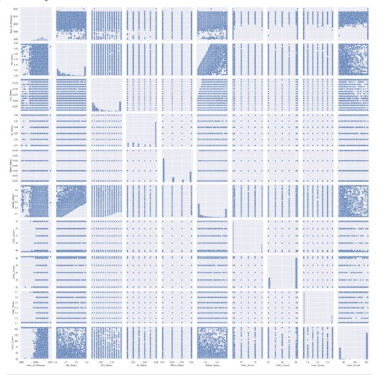
PAIR PLOT
RELATIONSHIP BETWEEN ONE ATTRIBUTE AND EVERY OTHER ATTRIBUTE IN DATASET.
DIFFERENT PLOTS ARE OBTAINED FOR EACH COMBINATION.

Slide 29
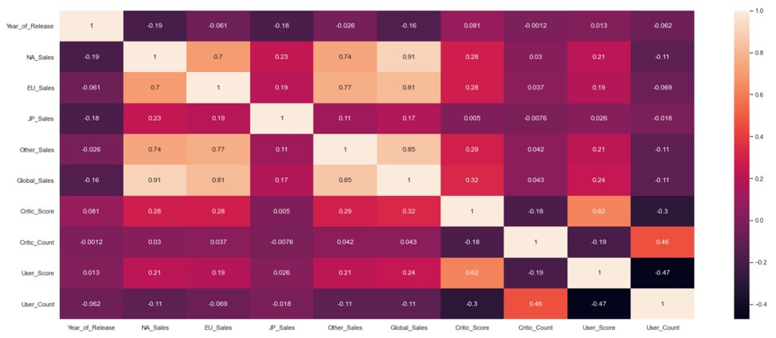
CORRELATION MATRIX
CORRELATION BETWEEN ALL COMBINATION OF VARIABLES
NEGATIVE CORRELATION AND POSITIVE CORRELATION CAN BE ANALYSED USING THIS MATRIX

Slide 30
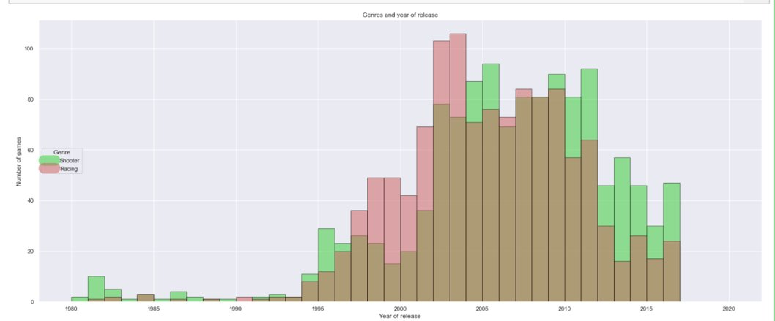
NUMBER OF GAMES, DEPENDING ON GENRE,YEAR OF RELEASE
RACING GAMES ARE SOLD MORE IN THE YEAR 200-2005 WHEREAS SHOOTING GAMES ARE SOLD MORE IN RANGE 2010-2015

Slide 31
MACHINE LEARNING MODELS

Slide 32
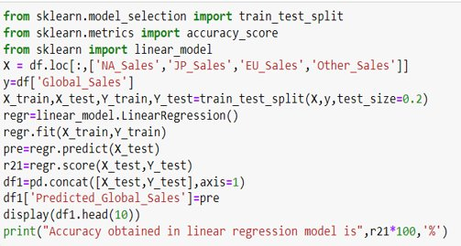
LINEAR REGRESSION
LINEAR REGRESSION USES THE RELATIONSHIP BETWEEN DATA POINTS TO FIT THE MODEL AND PREDICT THE VALUES.
​
TEST DATA -20% TRAIN DATA-80%​.
ATTRIBUTES HAVING MAXIMUM CORRELATION WITH THE GLOBAL SALES IS CHOSEN TO PREDICT THE VALUE OF GLOBAL SALES​

Slide 33
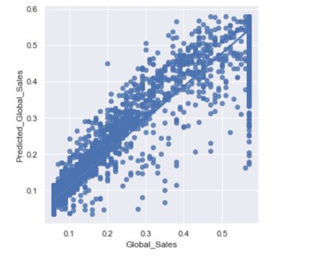
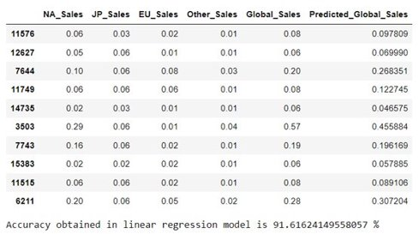
LINEAR REGRESSION PLOT

Slide 34
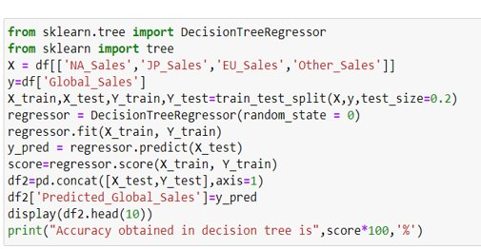
DECISION TREE ALGORITHM
Decision tree can be used to solve classification and regression problems.​
Root node-Entire sample​
Interior node-features of dataset​
Branches-decision rules​
Leaf nodes-outcome​
​

Slide 35
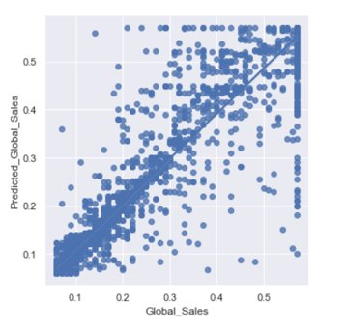
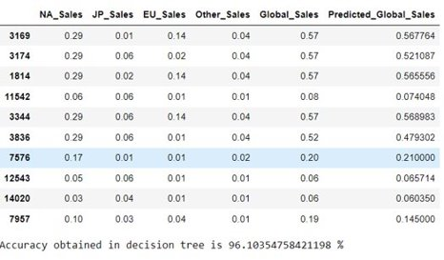
DECISION TREE PLOT

Slide 36
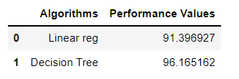
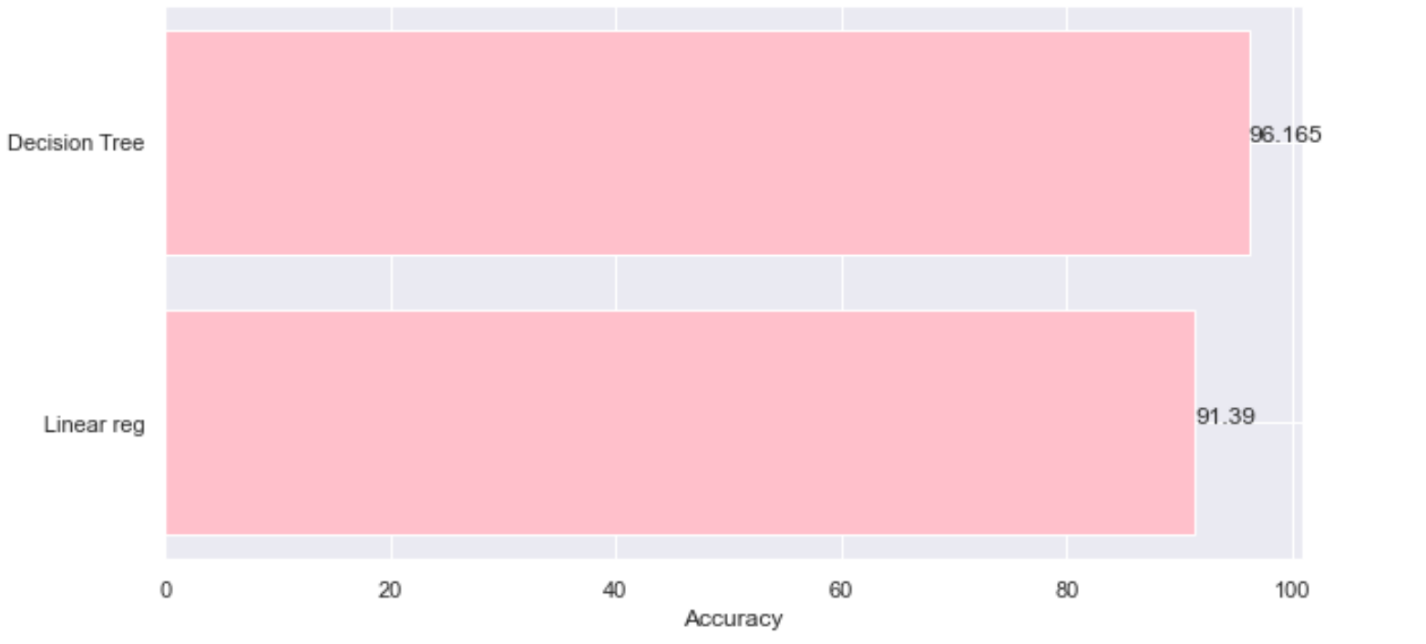
COMPARITIVE ANALYSIS
DECISION TREE HAS MORE ACCURACY WHEN COMPARED TO LINEAR REGRESSION.
SO, WE OPT FOR DECISION TREE.

Slide 37
THANK YOU!!

